Slide 1
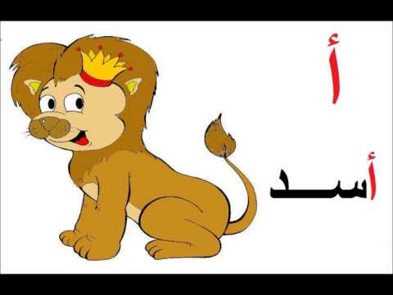
Agial Nursery
(Islamic – Languages)
Count – match – color – write
Name : ………………………………….
Date : ………………………………….
Class : ………………………………….
1
0
حضانة أجيال –عصرية- 25 عام من الخبرة
Comments and Suggestions
Circle the object that is up the table
Zero
One
count
count
count
 |  |  |  | 0 | 0 | 0 | 0
 |  |  |  | 1 | 1 | 1 | 1
Dictate the numbers ☺

Slide 2
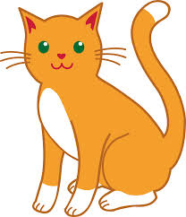
Agial Nursery
(Islamic – Languages)
Count – match – color – write
Name : ………………………………….
Date : ………………………………….
Class : ………………………………….
1
2
حضانة أجيال –عصرية- 25 عام من الخبرة
Comments and Suggestions
circle at lighter
count
count
count
2 | 1 | 2 | 1 | 2 | 1 | 2 | 1
Dictate the numbers ☺

Slide 3
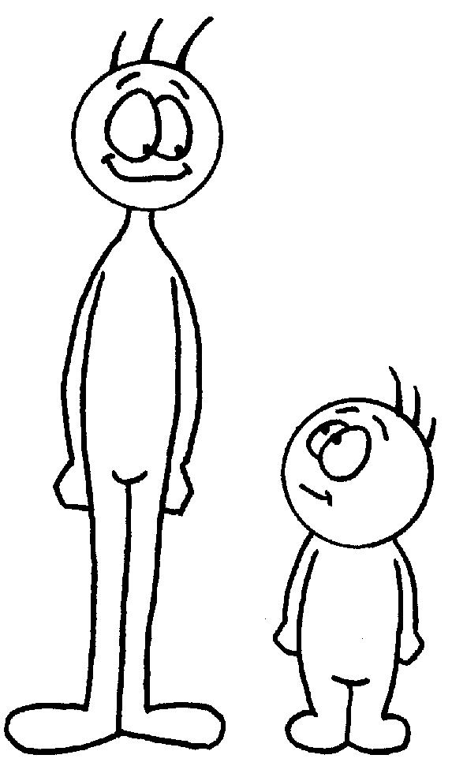
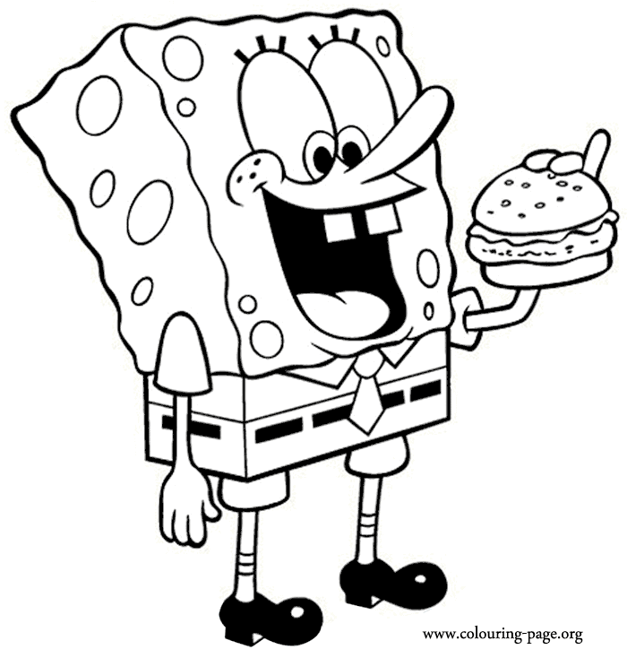
Count – match – color – write
Name : ………………………………….
Date : ………………………………….
Class : ………………………………….
Agial Nursery
(Islamic – Languages)
2
3
حضانة أجيال –عصرية- 25 عام من الخبرة
Comments and Suggestions
circle at short
count
count
count
2 | 3 | 2 | 3 | 2 | 3 | 2 | 1
Dictate the numbers ☺

Slide 4
Agial Nursery
(Islamic – Languages)
Count – match – color – write
Name : ………………………………….
Date : ………………………………….
Class : ………………………………….
4
حضانة أجيال –عصرية- 25 عام من الخبرة
count
Comments and Suggestions
Complete the shape ☺
3
circle at outside
4 | 4 | 4 | 4 | 4 | 3 | 2 | 1
Dictate the numbers ☺

Slide 5
Agial Nursery
(Islamic – Languages)
Count – match – color – write
Name : ………………………………….
Date : ………………………………….
Class : ………………………………….
4
حضانة أجيال –عصرية- 25 عام من الخبرة
Comments and Suggestions
Complete the shape ☺
5
count
circle at inside
5 | 5 | 5 | 4 | 4 | 3 | 2 | 1
Dictate the numbers ☺

Slide 6
Agial Nursery
(Islamic – Languages)
Count – match – color – write
Name : ………………………………….
Date : ………………………………….
Class : ………………………………….
5
حضانة أجيال –عصرية- 25 عام من الخبرة
Comments and Suggestions
Complete the shape ☺
6
count
Colour the heavier
6 | 5 | 6 | 5 | 6 | 5 | 4 | 3
Dictate the numbers ☺

Slide 7
Agial Nursery
(Islamic – Languages)
Count – match – color – write
Name : ………………………………….
Date : ………………………………….
Class : ………………………………….
6
حضانة أجيال –عصرية- 25 عام من الخبرة
Comments and Suggestions
Complete the shape ☺
7
count
Colour the shorter
6 | 7 | 6 | 7 | 6 | 7 | 6 | 5
Dictate the numbers ☺

Slide 8
Agial Nursery
(Islamic – Languages)
Count – match – color – write
Name : ………………………………….
Date : ………………………………….
Class : ………………………………….
7
حضانة أجيال –عصرية- 25 عام من الخبرة
Comments and Suggestions
Complete the shape ☺
8
count
Colour the taller
8 | 8 | 7 | 8 | 7 | 8 | 7 | 6
Dictate the numbers ☺

Slide 9
Agial Nursery
(Islamic – Languages)
Count – match – color – write
Name : ………………………………….
Date : ………………………………….
Class : ………………………………….
8
حضانة أجيال –عصرية- 25 عام من الخبرة
Comments and Suggestions
Complete the shape ☺
9
count
Color the lighter
8 | 9 | 8 | 9 | 8 | 9 | 8 | 7
Dictate the numbers ☺

Slide 10
Agial Nursery
(Islamic – Languages)
Count – match – color – write
Name : ………………………………….
Date : ………………………………….
Class : ………………………………….
9
حضانة أجيال –عصرية- 25 عام من الخبرة
Comments and Suggestions
Complete the shape ☺
10
count
Color the down
9 | 10 | 9 | 10 | 9 | 10 | 9 | 8
Dictate the numbers ☺

Slide 11
Agial Nursery
(Islamic – Languages)
Count – match – color – write
Name : ………………………………….
Date : ………………………………….
Class : ………………………………….
حضانة أجيال –عصرية- 25 عام من الخبرة
11
Comments and Suggestions
Complete the shape ☺
count
10
11 | 11 | 10 | 11 | 10 | 11 | 10 | 9
Dictate the numbers ☺

Slide 12
Agial Nursery
(Islamic – Languages)
Count – match – color – write
Name : ………………………………….
Date : ………………………………….
Class : ………………………………….
حضانة أجيال –عصرية- 25 عام من الخبرة
11
Comments and Suggestions
Complete the shape ☺
count
12
11 | 12 | 11 | 12 | 11 | 12 | 11 | 10
Dictate the numbers ☺

